Slide 1
BT201
Biochemical Calculations
13/09/2022

Slide 2

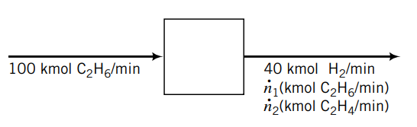

BALANCES ON REACTIVE PROCESSES
Balances on Molecular and Atomic Species
Dehydrogenation of ethane in a steady-state continuous reactor.
One hundred kmol/min of ethane is fed to the reactor.
The molar flow rate of H2 in the product stream is 40 kmol/min.
A number of different balances could be written on this process,
balances on total mass, C2H6 , C2H4 , and H2 . Of these, only the first has the simple form input=output,
since the three given species all participate in the reaction, the balance equation for each of them must include a generation term or a consumption term

Slide 3
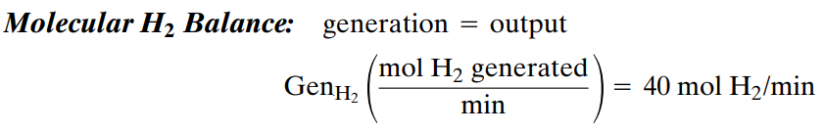
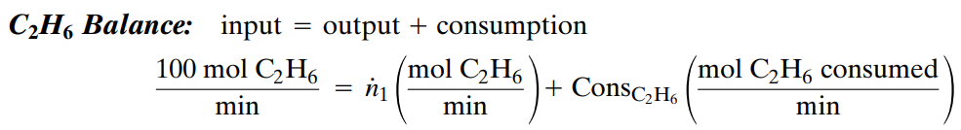
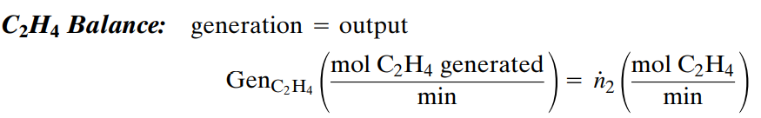
MolecularBalance:
Rate of accumulation = rate of input + rate of generation - rate of output – rate of consumption
At steady state

Slide 4
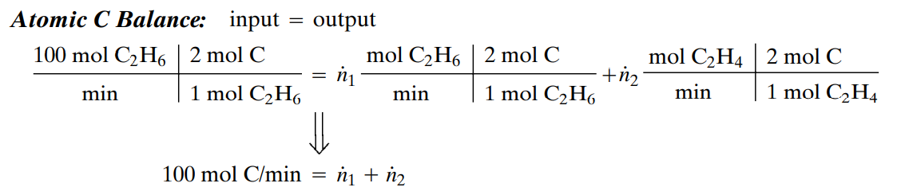
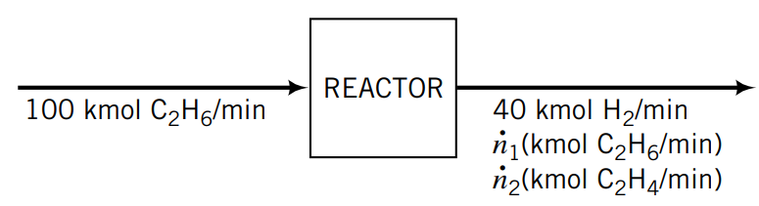
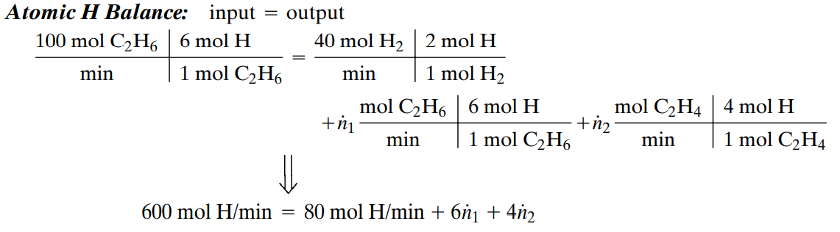
Balances on Atomic Species
Notice, however, that balance equations may also be written for atomic carbon and atomic hydrogen, regardless of the molecular species in which the carbon and hydrogen atoms happen to be found. Balances on atomic species be written since atoms can neither be created (generation 0) nor destroyed (consumption 0) in a chemical reaction.
Two unknown and two equations

Slide 5
In general, systems that involve chemical reactions may be analyzed using
molecular species balances (the approach always used for nonreactive systems),
atomic species balances, and
extents of reaction.
Each approach leads to the same results, but any one of them may be more convenient for a given calculation

Slide 6
Degree of freedom for molecular species balances
If molecular species balances are used to determine unknown stream variables for a reactive process, the balances on reactive species must contain generation and/or consumption terms. The degree-of-freedom analysis is as follows:
No. unknown labeled variables
+ no. independent chemical reactions
- No. independent molecular species balances
- No. other equations relating unknown variables
= No. degrees of freedom

Slide 7
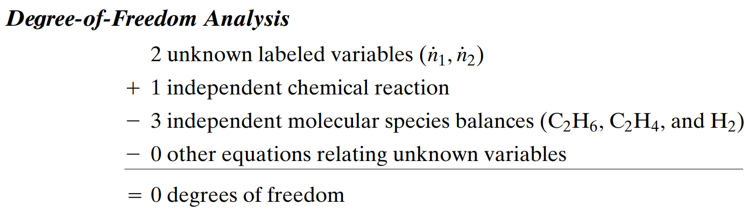

Slide 8
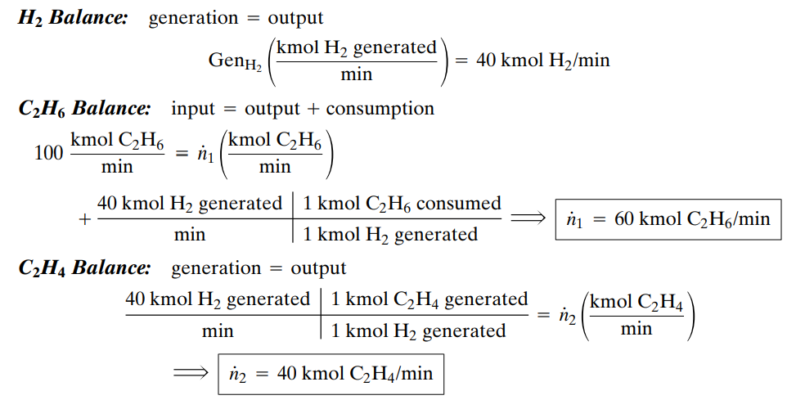

Slide 9
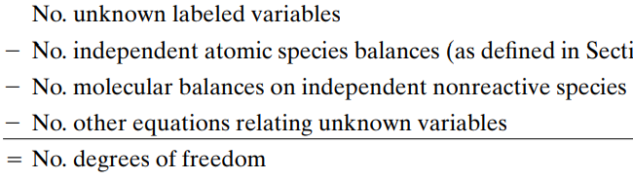
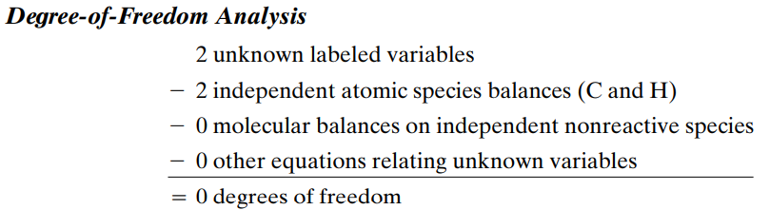
Degree of freedom for atomic balances
All balances on atomic species (C, H, O, etc.) take the form “input=output,” since atomic species can neither be generated nor consumed in chemical reactions (as opposed to nuclear reactions).
The number of degrees of freedom is determined directly by subtracting equations from labeled unknowns: no additional degrees of freedom are contributed by the reactions.

Slide 10


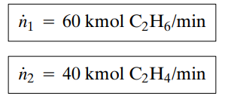
C balance : input=output
H balance : input=output

Slide 11
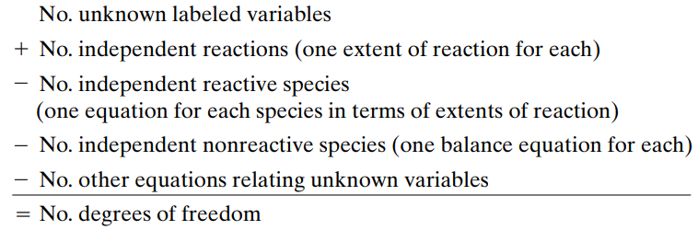
Degree of freedom for the calculation based on extents of reaction
The third way to determine unknown molar flow rates for a reactive process is to write expressions for each product species flow rate (or molar amount) in terms of extents of reaction, substitute known feed and product flow rates, and solve for the extents of reaction and the remaining reactive species flow rates.
The degree-of-freedom analysis follows:

Slide 12
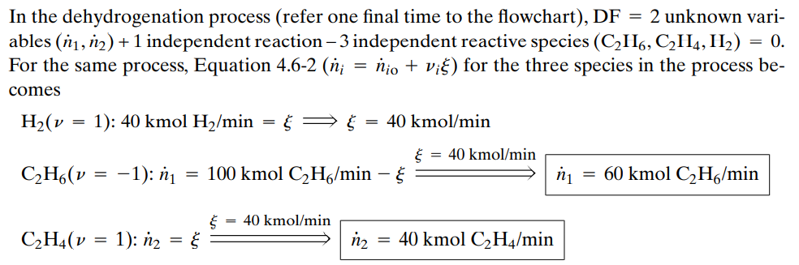

Slide 13
Given that all three methods of carrying out material balances on reactive systems:
molecular species balances,
atomic species balances, and
extents of reaction—necessarily yield the same results,
The question is which one to use for a given process. There are no hard and fast rules but we suggest the following guideline
Atomic species balances generally lead to the most straightforward solution procedure, especially when more than one reaction is involved.
Extents of reaction are convenient for chemical equilibrium problems
Molecular species balances require more complex calculations than either of the other two approaches and should be used only for simple systems in ol in one reaction.

Slide 14

Incomplete Combustion of Methane
Methane is burned with air in a continuous steady-state combustion reactor to yield a mixture of carbon monoxide, carbon dioxide, and water. The reactions taking place a
The feed to the reactor contains 7.80 mole% CH4 , 19.4% O2 , and 72.8% N2 . The percentage conversion of methane is 90.0%, and the gas leaving the reactor contains 8 mol CO2 /mol CO.
Carry out a degree-of-freedom analysis on the process.
Then calculate the molar composition of the product stream using molecular species balances, atomic species balances, and extents of reaction

Slide 15
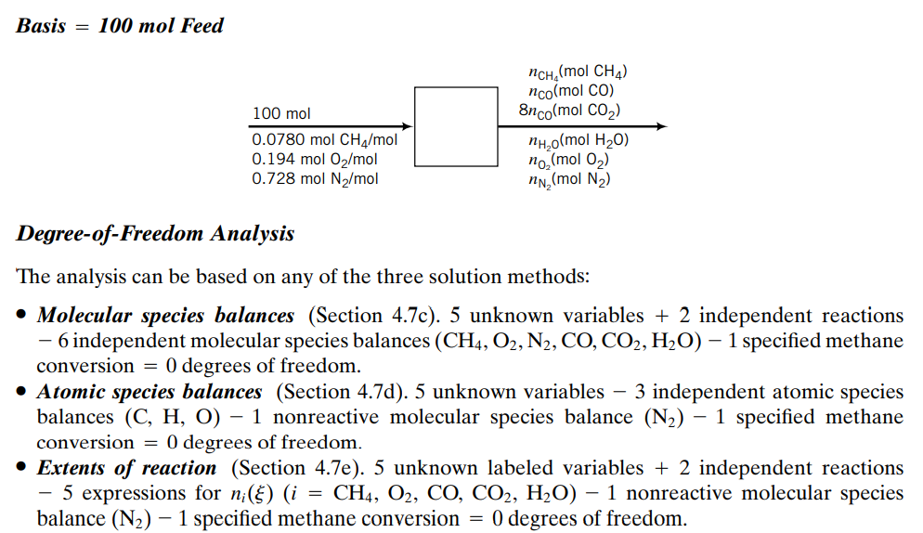


Slide 16
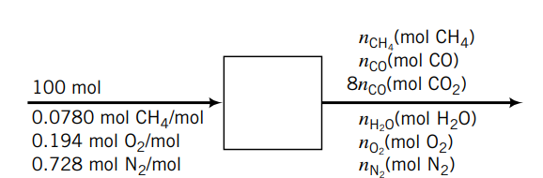
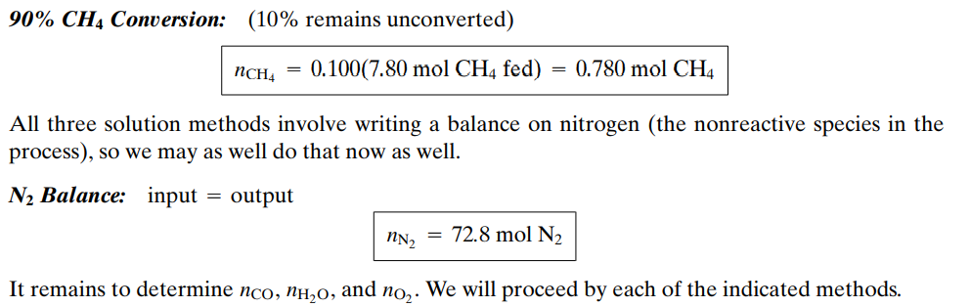
Before balances are written, the specified methane conversion can be used to determine

Slide 17
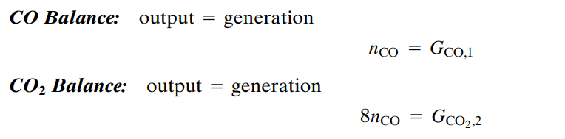
Molecular Species Balances

Slide 18
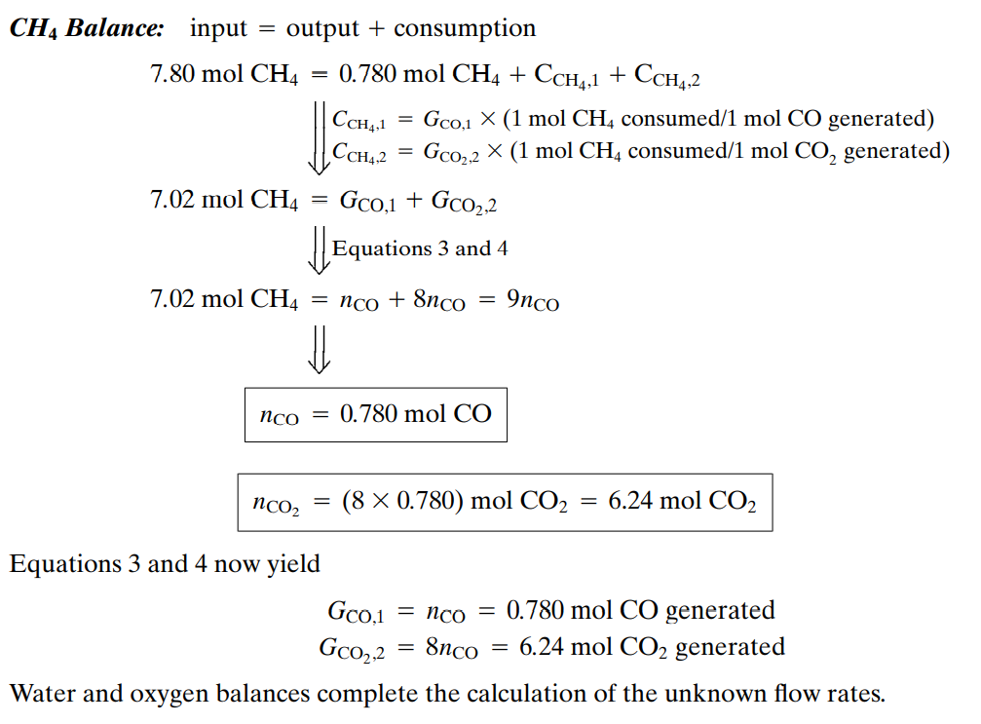
Cont..

Slide 19
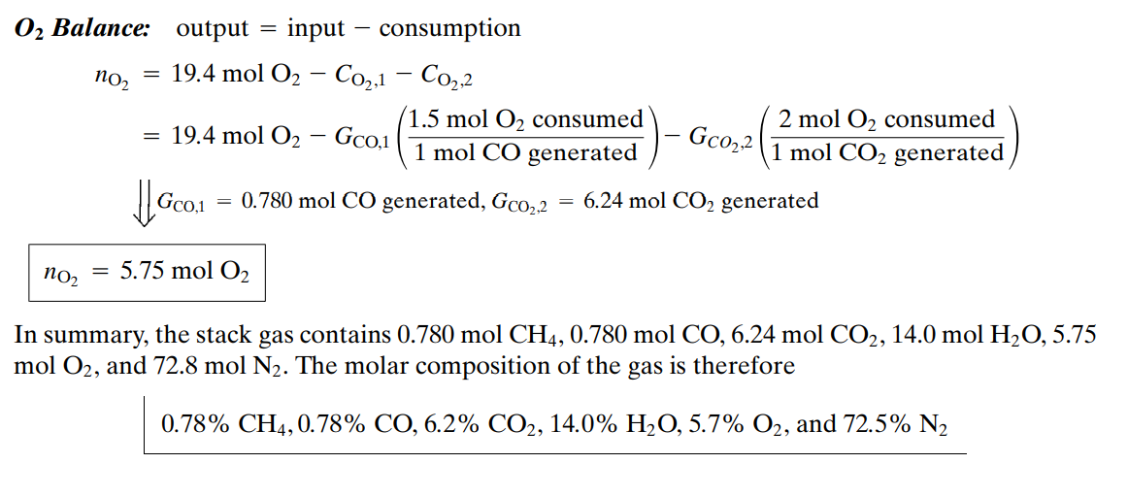

Slide 20
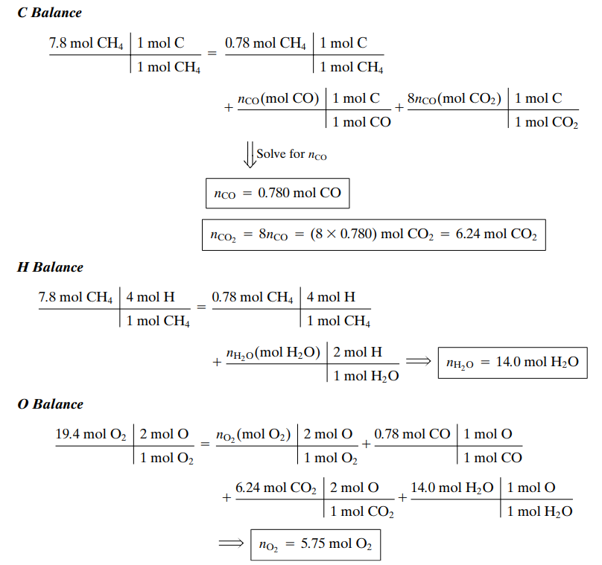
Atomic Species Balances

Slide 21
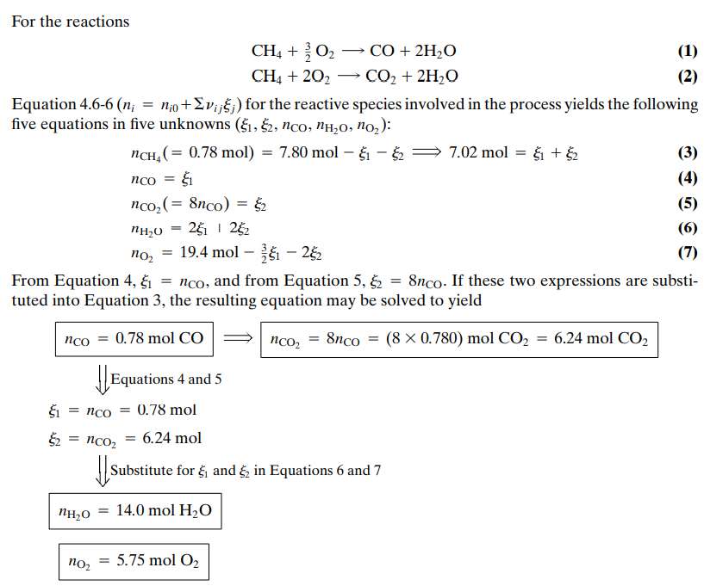
Extents of reaction

